Slide 1




Peoples Empowerment Group
ISBM COLLEGE OF ENGINEERING, NANDE, PUNE
A
Project Presentation
On
IOT Scribe System for Visually Impaired Students
Team Members:- 1.Sanket Sherki
2.Om Rajesh Mallepelli
3.Vaishnav Waghre
4.Chaitanya Somuse

Slide 2
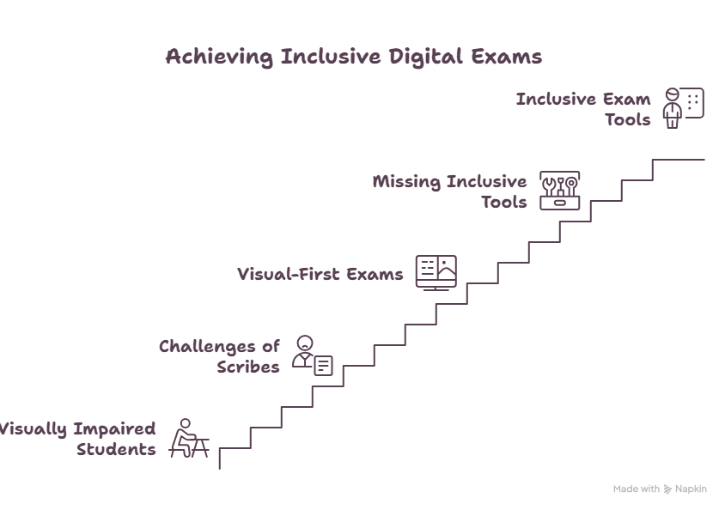
1.PROBLEM STATEMENT
The Reality Today:
• Visually impaired students depend on human scribes
• Leads to bias, privacy loss & recurring cost
• Existing digital exams are visual-first
• Inclusive exam tools are missing

Slide 3
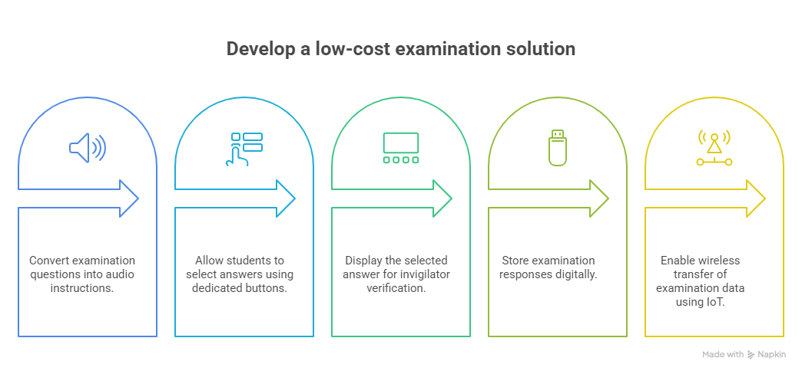
2.ABSTRACT AND INTRODUCTION
Design an assistive examination device for visually impaired students.
Convert examination questions into audio instructions.
Allow students to select answers using dedicated buttons.
Display the selected answer for invigilator verification.
Store examination responses digitally.
Enable wireless transfer of examination data using IoT.
Develop a low-cost and user-friendly solution.

Slide 4
3.Literature Survey
• Paper 1 (2025):Assistive Technologies for the Visually Impaired: A Review.
• Focus: speech interfaces, multimodal interaction, wearable devices and accessibility.
• Key relevance: audio and user-friendly assistive interfaces improve accessibility.
• Paper 2 (2026): IoT-powered Wearable Assist Device for Visually Impaired.
• Focus: IoT, embedded hardware, sensors and voice feedback.
• Research gap: many systems focus on mobility/environmental assistance; our project focuses specifically on examination assistance

Slide 5
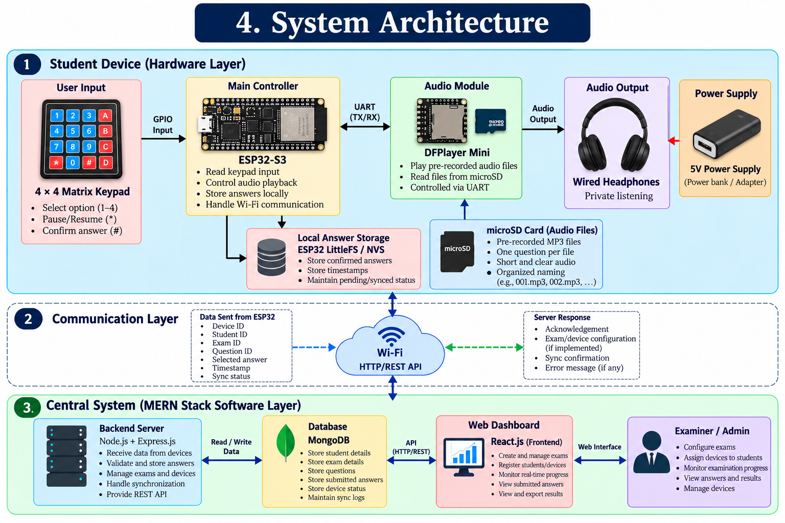

Slide 6
5.Software Requirement Specification - Functional
Student Device
Play current question audio
Repeat question
Pause/resume audio
Select options A–D
Change selected answer
Confirm answer
Store answer locally
Synchronize answers with server
Retry pending answers
Central System
Register examination devices
Associate device with student
Receive answer records
Store answers
Track synchronization
Monitor device status
Display examination progress

Slide 7
5.Software Requirement Specification –
Non-Functional
Non-Functional Requirements
Accessibility
Reliability
Low response time
Offline tolerance
Data integrity
Security
Scalability for multiple devices
Simple user interaction

Slide 8
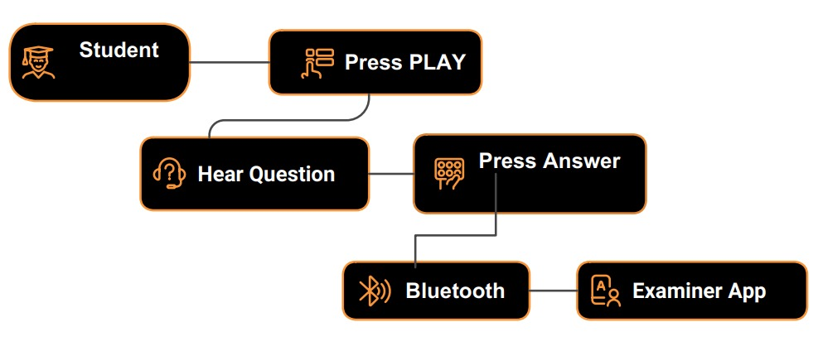
6.Proposed System
Workflow
Teacher uploads MCQ questions.
ESP32 controls the entire system.
DFPlayer Mini plays question audio.
Student listens to:
  Question
  Option A
  Option B
  Option C
  Option D
Student presses answer button.
OLED displays selected option.
Answer is stored.
Data is sent via Wi-Fi to teacher/server.
Final score/report is generated.

Slide 9
7.Module Split-up
Module 1 — Audio Question Module
Question audio storage
MP3 playback
Play/pause/resume
Question repetition
Module 2 — Student Interaction Module
Keypad scanning
Option selection
Answer modification
Confirmation
Module 3 — Local Data Management
Answer storage
Timestamp
Pending/synced status
Recovery after restart
Module 4 — IoT Communication
Wi-Fi connection
Device identification
Answer transmission
Acknowledgement
Retry mechanism
Module 5 — Central Backend
API/MQTT message handling
Student/device management
Answer processing
Database operations
Module 6 — Examination Dashboard
Device status
Student progress
Question progress
Submitted answers
Synchronization status

Slide 10
8.Algorithms/Techniques
• Question Playback: identify question → locate audio file → play →wait for input.
• Answer Selection: read key → map 1/2/3/4 → set selected option.
• Confirmation: display selection → press # → validate → save →next question.
• Control Logic: 0 = replay; * = pause/resume; # = confirm.
• IoT Transfer: create response packet → connect Wi-Fi → transmit →server stores →dashboardupdates.
• Input debouncing and validation should be used for reliable keypad operation.

Slide 11
9.Software Tools and Technologies
1. Embedded System
ESP32-S3 Development Board
Arduino IDE
Embedded C/C++
DFPlayer Mini Library
LittleFS / NVS for local answer storage
2. Hardware Design
Cirkit Designer
Breadboard and Jumper Wires
DFPlayer Mini and 4×4 Matrix Keypad
3. Communication
Wi-Fi
HTTP/REST API
JSON for data exchange
4. Backend Development
Node.js
Express.js
REST API
4. Backend Development
Node.js
Express.js
REST API
5. Frontend Development
React.js
HTML5
CSS3
JavaScript
6. Database
MongoDB
7. Design & Documentation
Draw.io (diagrams.net) — UML diagrams and system architecture
Microsoft PowerPoint — Project presentation

Slide 12
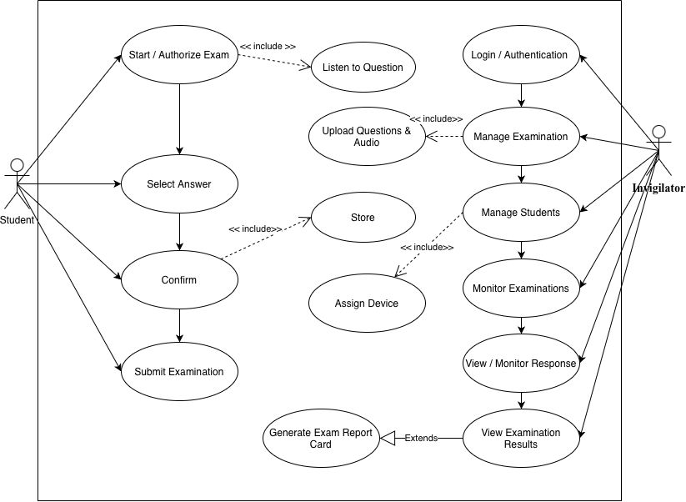
10.UML Diagrams(Use Case)

Slide 13
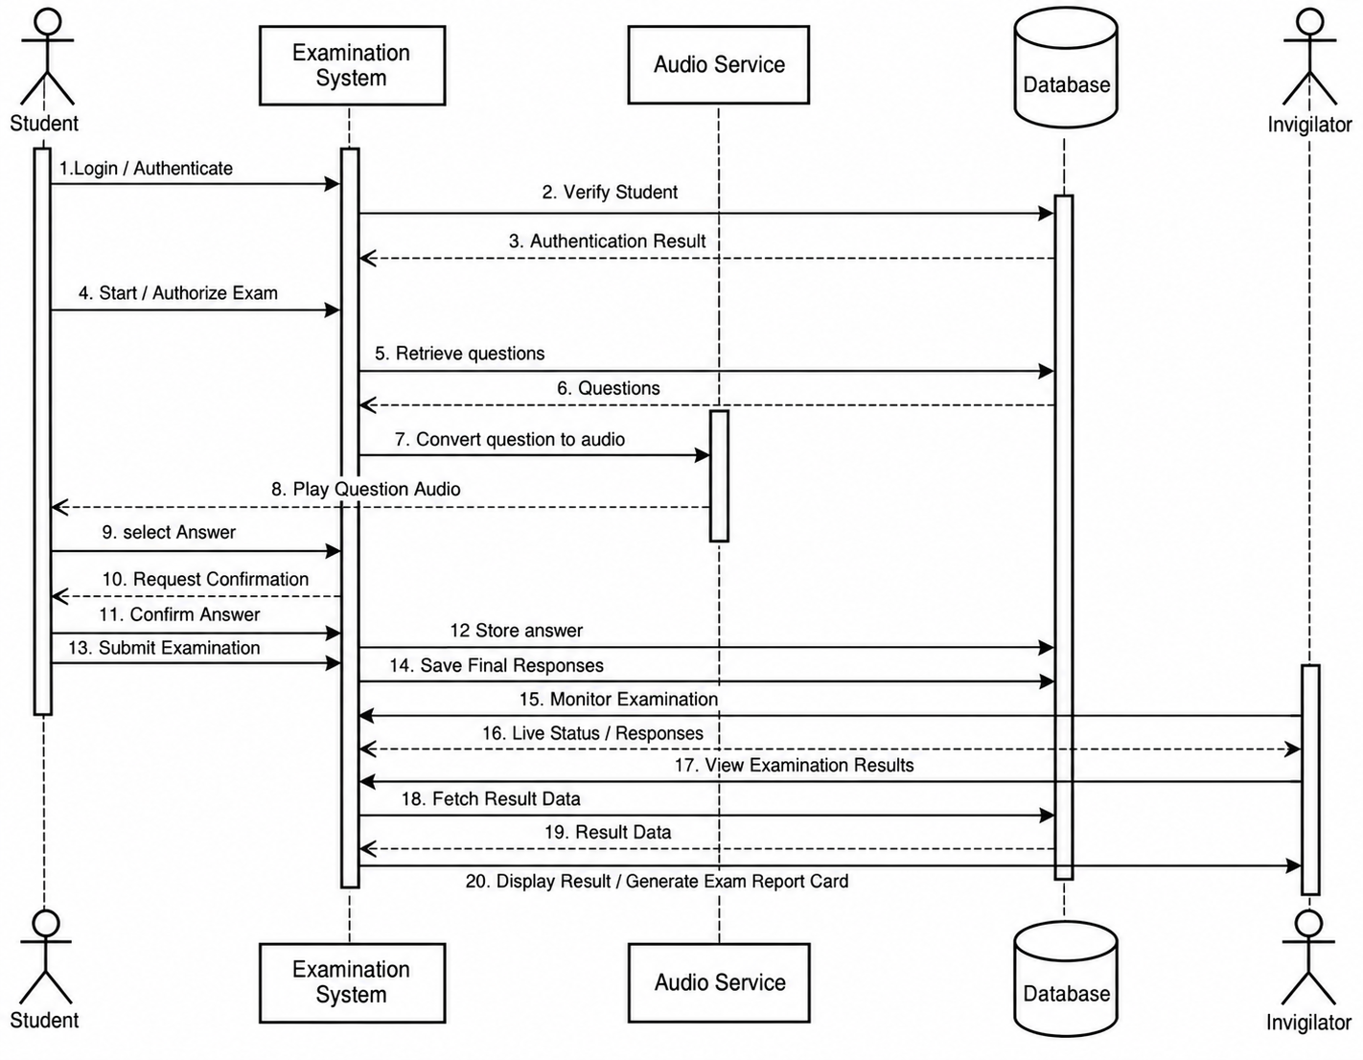
10.UML Diagrams(Sequence Diagram)

Slide 14
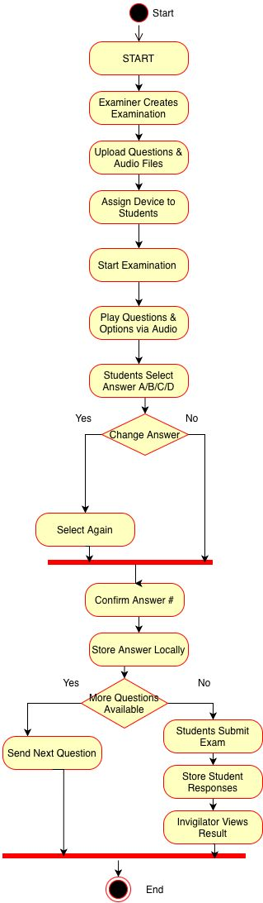
10.UML Diagrams(Activity Diagram)

Slide 15
11.Project Plan 2.0
1. Hardware Implementation
Assemble and test the designed circuit.
Verify keypad input and audio playback.
2. Embedded Software Development
Program the ESP32-S3.
Implement question navigation and answer handling.
3. Full-Stack Web Development
Develop the React dashboard.
Build the Node.js/Express backend and MongoDB database.
4. IoT Communication
Establish Wi-Fi connectivity.
Implement answer transmission and offline synchronization.
5. System Integration
Integrate hardware, firmware, backend and dashboard.
Enable centralized examination monitoring.
6. Testing and Validation
Test functionality, reliability and data accuracy.
Resolve hardware and software issues.
7. Final Demonstration and Documentation
Complete the working prototype.
Prepare the final report and project demonstration.

Slide 16
12.Project Scope, Feasibility & Requirement
Scope
In Scope
Audio-based MCQ examination
Keypad interaction
Local answer storage
Wi-Fi synchronization
Multiple examination devices
Central monitoring
Future Scope
Text-to-speech
Voice feedback
More examination formats
Advanced accessibility features
Secure authentication
Large-scale deployment
Feasibility
Technical: ESP32-S3, DFPlayer and Wi-Fi are suitable for the prototype.
Economic: Uses relatively low-cost embedded hardware.
Operational: Simple keypad + audio interface is suitable for the target interaction. want future scope base on currect project status

Slide 17
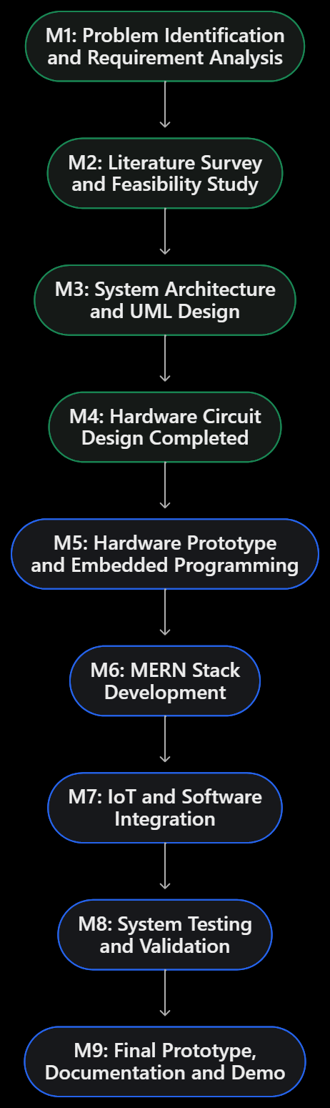
13.Timeline/Milestone
Milestone | Activity | Status
M1 | Problem identification and requirements | Completed
M2 | Literature survey and feasibility study | Completed / initial
M3 | System architecture and UML design | Designed
M4 | Hardware circuit design | Completed
M5 | Physical prototype and ESP32 programming | Planned
M6 | React, Node.js, Express and MongoDB development | Planned
M7 | Hardware–software integration | Planned
M8 | Testing and validation | Planned
M9 | Final demonstration and documentation | Planned

Slide 18
Thank You

